Slide 1

Chapter 2 Part 2
Data Models
The slides in this presentation have been adapted from slides provided with the textbook, Database Systems: Design, Implementation, and Management,
12E, Cornel and Morris, Copyright © 2017 Cengage Learning.

Slide 2
Learning Objectives
How the major data models evolved
About emerging alternative data models and the need they fulfill
How data models can be classified by their level of abstraction
Copyright © 2017 Cengage Learning
2

Slide 3
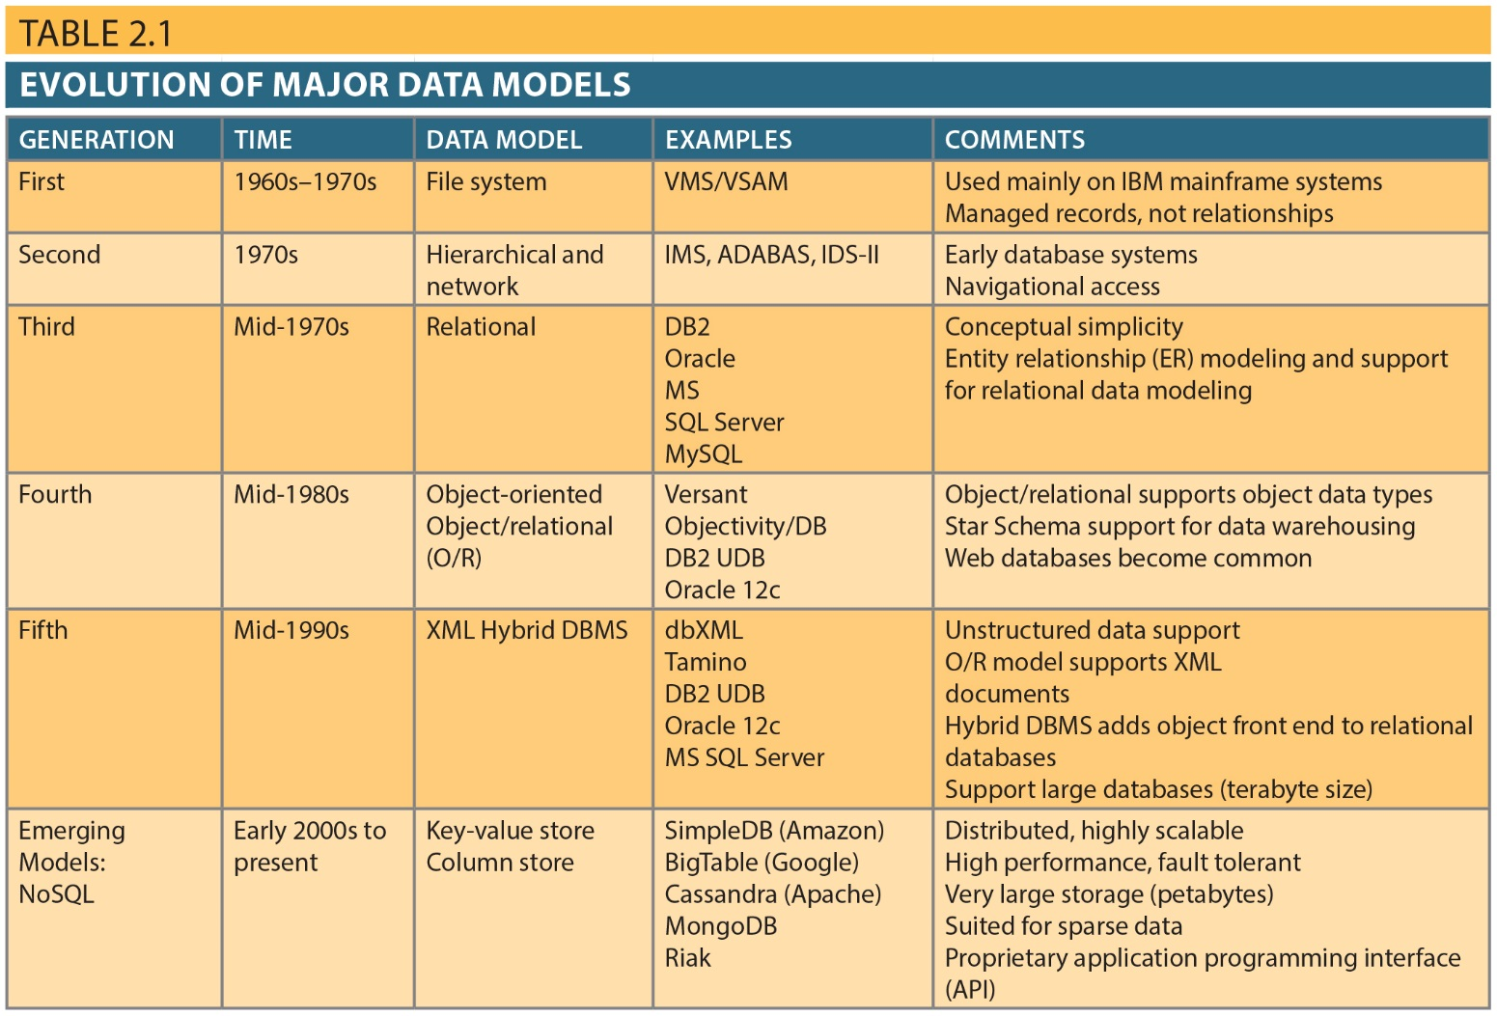
The Evolution of Data Models
Copyright © 2017 Cengage Learning
3

Slide 4
The Relational Model
Developed by E.F. Codd (IBM) in 1970
Table (relations)
Matrix consisting of row/column intersections
Each row in a relation is called a tuple
Relational models were considered impractical in 1970
Model was conceptually simple at expense of computer overhead
Copyright © 2017 Cengage Learning
4

Slide 5
The Relational Model (cont’d.)
Relational data management system (RDBMS)
Performs same functions provided by hierarchical model
Hides complexity from the user
Relational model
Representation of entities, attributes, and relationships
Textual: TableName(Keyname, a1, a2, foreignKey)
Example
Agent(Agent_Code, Agent_Fname, Agent_Lname, Agent_Initial, Agent_Areacode, Agent_Phone)
Customer(Cus_Code, Cus_Fname, Cus_Lname, Cus_Initial, Cus_Areacode, Cus_Phone, Cus_Insure_Type, Cus_Insure_Amount, Cus_Renew_Date, Cus_Agent_Code)
Copyright © 2017 Cengage Learning
5

Slide 6
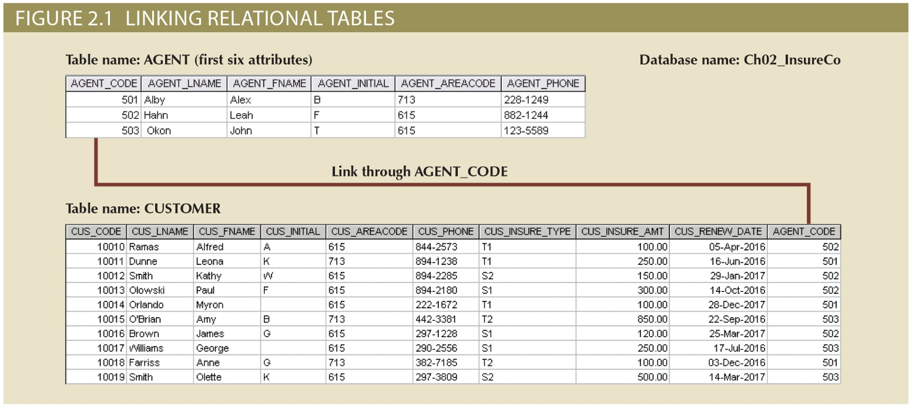
Copyright © 2017 Cengage Learning
6

Slide 7
Databases are used by Programs
SQL-based relational database application involves three parts: OnlineSurveySystem
End-user interface
Allows end user to interact with the data
ASP interface that collects survey responses
Set of tables stored in the database
Each table is independent from another
Rows in different tables are related based on common values in key and foreign key attributes
MS Access tables: Item, participant, response, survey, etc.
SQL “engine”
Executes all queries
MS Jet engine
Copyright © 2017 Cengage Learning
7

Slide 8
The Entity Relationship Model
Widely accepted standard for data modeling
Introduced by Chen in 1976
Graphical representation of entities and their relationships
Shows structure of Key->Foreign Key relationships among tables in a database
Entity relationship diagram (ERD)
Uses graphic representations to model database components
Entity is mapped to a relational table
Copyright © 2017 Cengage Learning
8

Slide 9
Online Survey Entity Relationship Diagram (ERD)
Copyright © 2017 Cengage Learning
9

Slide 10
The Entity Relationship Model (cont’d.)
Entity instance (or occurrence) is row in table
Entity set is collection of like entities/instances
Connectivity labels types of relationships
Crow’s Foot notation used as design standard in this book
Copyright © 2017 Cengage Learning
10

Slide 11
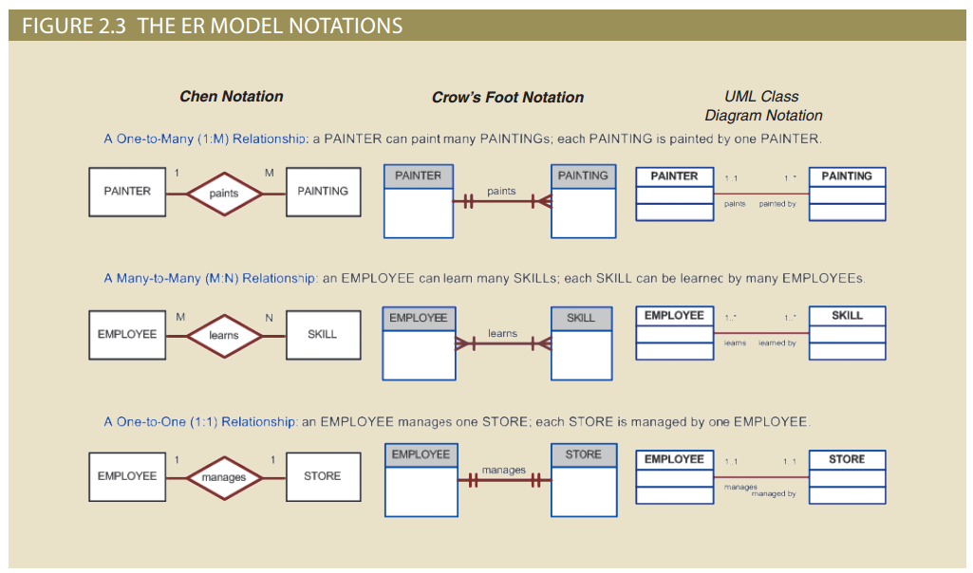
Copyright © 2017 Cengage Learning
11

Slide 12
Task
Create an ER diagram with a one to many relationship for a problem domain of your choice.
Create the relational model that matches your ER diagram.
Copyright © 2017 Cengage Learning
12

Slide 13
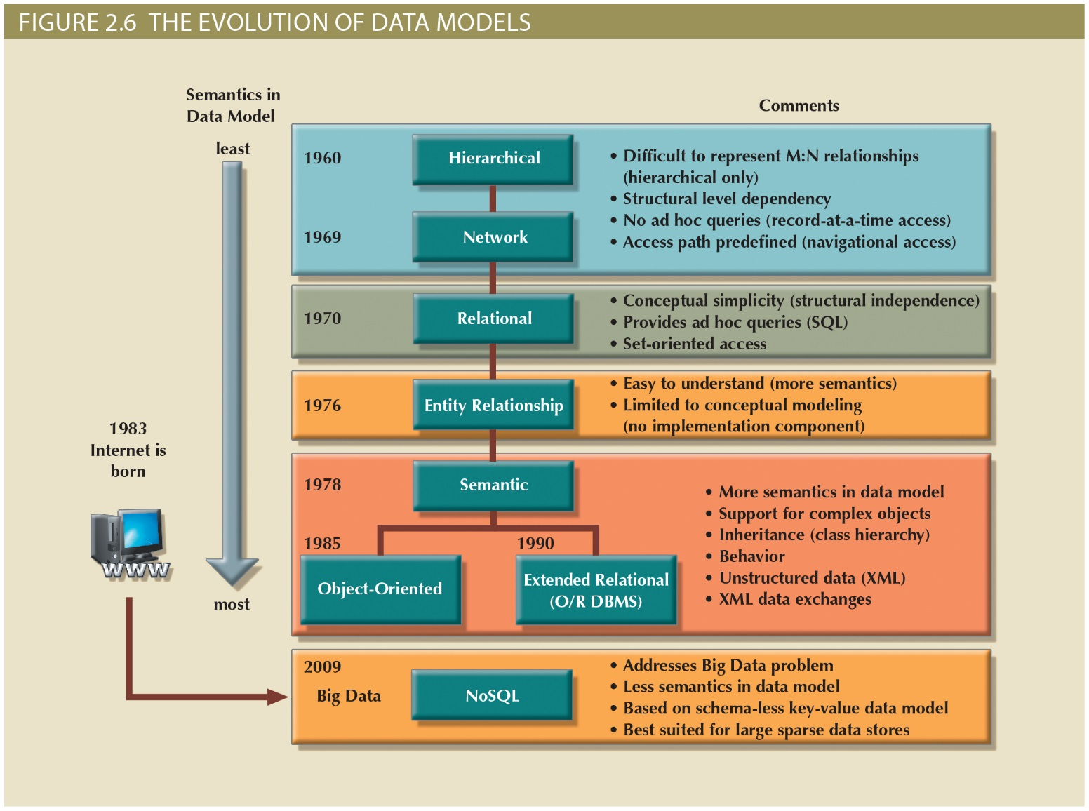
Copyright © 2017 Cengage Learning
13

Slide 14
The Object-Oriented Data Model (OODM) or Semantic Data Model
Object-oriented database management system(OODBMS)
Based on OODM
Object: Contains data and their relationships with operations that are performed on it
Basic building block for autonomous structures
Abstraction of real-world entity
Attributes - Describe the properties of an object
Copyright © 2017 Cengage Learning
14

Slide 15
The Object-Oriented Data Model (OODM)
Class: Collection of similar objects with shared structure and behavior organized in a class hierarchy
Class hierarchy: Resembles an upside-down tree in which each class has only one parent
Inheritance: Object inherits methods and attributes of parent class
Unified Modeling Language (UML)
Describes sets of diagrams and symbols to graphically model a system
Copyright © 2017 Cengage Learning
15

Slide 16
Object-Oriented Model
Advantages
Disadvantages
Semantic content is added
Visual representation includes semantic content
Inheritance promotes data integrity
Slow development of standards caused vendors to supply their own enhancements
Compromised widely accepted standard
Complex navigational system
Learning curve is steep
High system overhead slows transactions
Copyright © 2017 Cengage Learning
16

Slide 17
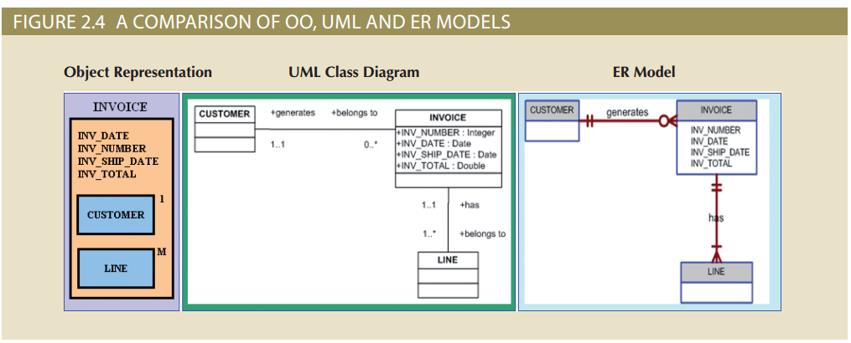
Figure 2.4 - A Comparison of OO, UML, and ER Models
Copyright © 2017 Cengage Learning
17

Slide 18
Object/Relational and XML
Extended relational data model (ERDM)
Supports OO features and complex data representation
Object/Relational Database Management System (O/R DBMS)
Based on ERDM, focuses on better data management
Extensible Markup Language (XML): the standard protocol for data exchange among systems and Internet services
Internet created the potential to exchange critical business information
Extensible Markup Language (XML) emerged as the de facto standard
Manages unstructured data for efficient and effective exchange of all data types
Copyright © 2017 Cengage Learning
18

Slide 19
Summary
Data models evolved as data and operating environments became more complex
Emerging data models attempt to fill needs for analyzing unstructured data
Higher levels of abstraction help simplify understanding data in complex situations
Copyright © 2017 Cengage Learning
19

Slide 20
Task
Identify three 1:M relationships: ___________________________________
Briefly explain why different data model notations are not important? (hint: it is about the data being stored) ___________________________________
Speculate about whether you think UML class diagrams will be the last data modeling tool ever proposed ___________________________________
Copyright © 2017 Cengage Learning
20

